Slide 1
Exploring Pip Movement Across Trading Session and Overlaps
BRIGHT RIKIN
CAPITAL MARKET ANALYST AT PIPRAISERS

Slide 2
The Importance of the Four mentioned trading sessions with facts and Figures.
The importance of the four major trading sessions—Sydney, Tokyo, London, and New York—lies in their impact on market liquidity, volatility, and trading opportunities, as revealed by pip movement data from the analysis. Below is an overview based on facts and figures

Slide 3
Sydney Session
Importance:
Represents the start of the forex trading day.
Crucial for trading AUD and NZD due to their local relevance.
Generally lower volatility, making it suitable for beginners or risk-averse traders.
Facts:
Average pip movements for AUD/USD were around 34.8 across 10 days.
Gold exhibited modest activity with average movements of approximately 47.5 pips in this session.

Slide 4
Tokyo Session
Importance:
Second-largest trading market globally.
Known for significant movements in JPY pairs, as it overlaps partially with the Sydney session.
Typically exhibits stable trends due to high participation from Asian institutions.
Facts:
USD/JPY showed consistent pip movements averaging 65.3 during the overlap with Sydney.
AUD/JPY experienced its peak activity with movements averaging 71.6 across 10 days.

Slide 5
London Session
Importance:
The largest and most active session, accounting for about 43% of daily forex turnover.
High volatility makes it ideal for traders looking to capitalize on price movements.
Most currency pairs show their largest pip movements during this session.
Facts:
Gold displayed high average pip movements of around 62.2 during the London session.
EUR/USD, a widely traded pair, saw average pip movements of approximately 45.8.

Slide 6
New York Session
Importance:
Completes the 24-hour forex cycle, overlapping with the London session.
Heavily influenced by news from North America, which can lead to sharp price changes.
A major player in trading USD pairs.
Facts:
During the London & New York overlap, Gold showed the highest pip movements, averaging 92.3.
AUD/USD also saw substantial volatility, with an average movement of 50.7 pips during this overlap.

Slide 7
Overlapping Sessions
Sydney & Tokyo: Stable, moderate volatility. Key for JPY pairs.
Example: USD/JPY averaged 58.4 pips.
Tokyo & London: Most volatile due to the influx of European traders, driving major JPY and EUR pairs.
Example: EUR/USD averaged 78.2 pips.
London & New York: Peak activity due to overlapping liquidity and news releases.
Example: Gold hit its highest pip movement of 92.3.

Slide 8
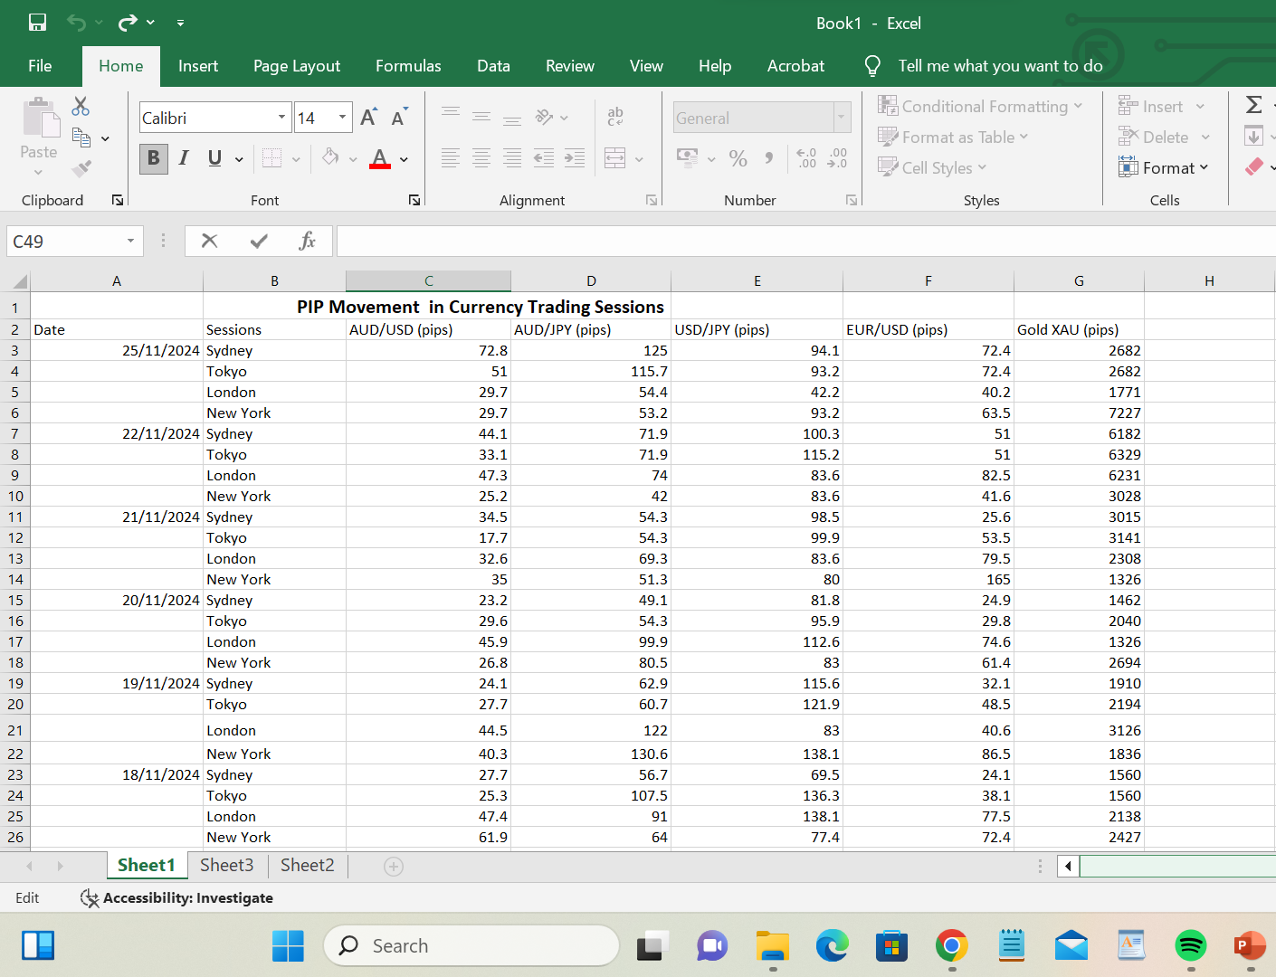
PIP Movement in Currency Trading Sessions

Slide 9
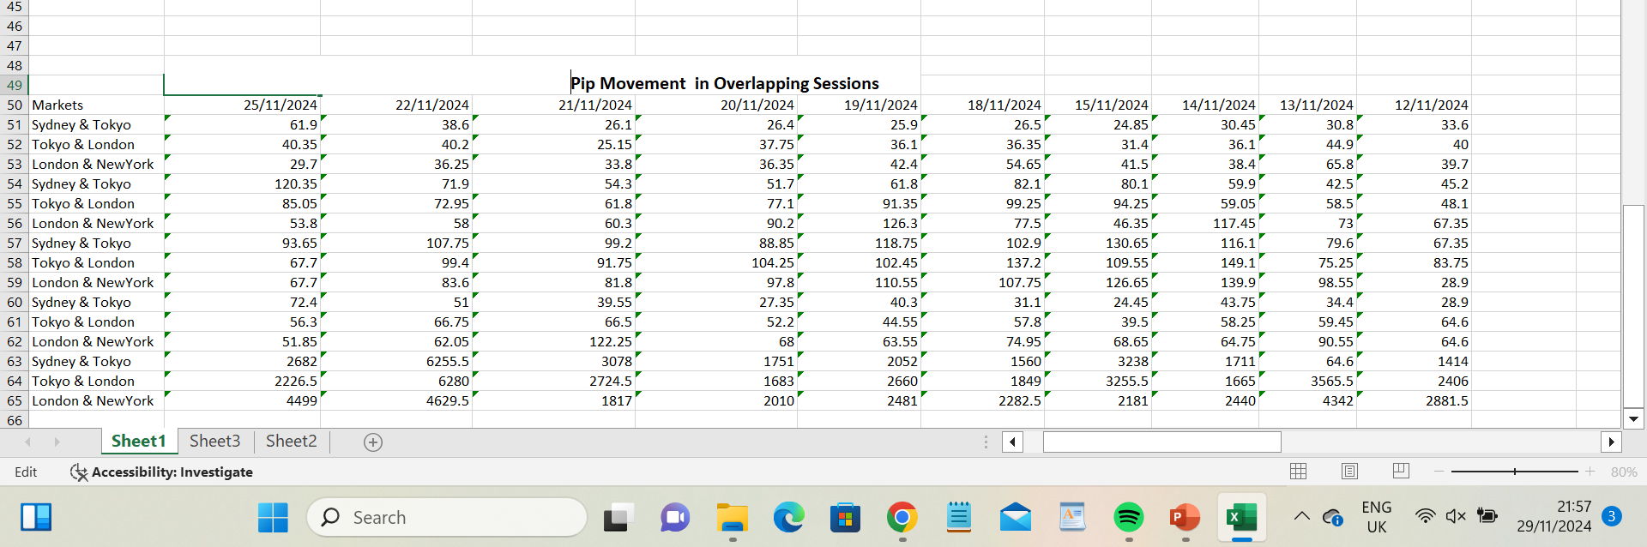
PIP Movement in Overlapping Sessions

Slide 10
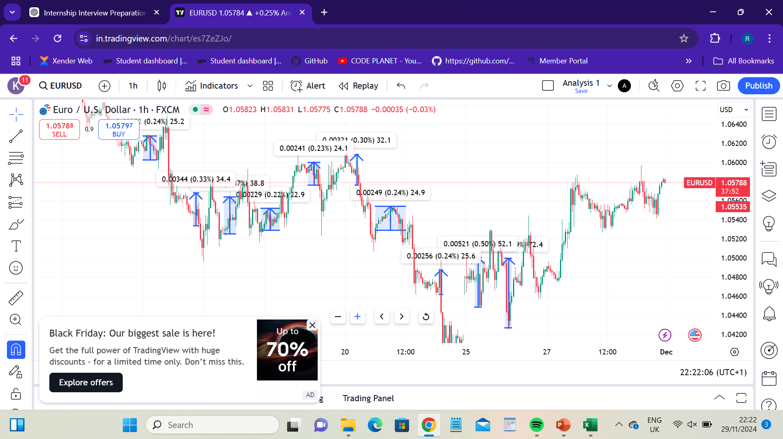
Trading Session View

Slide 11
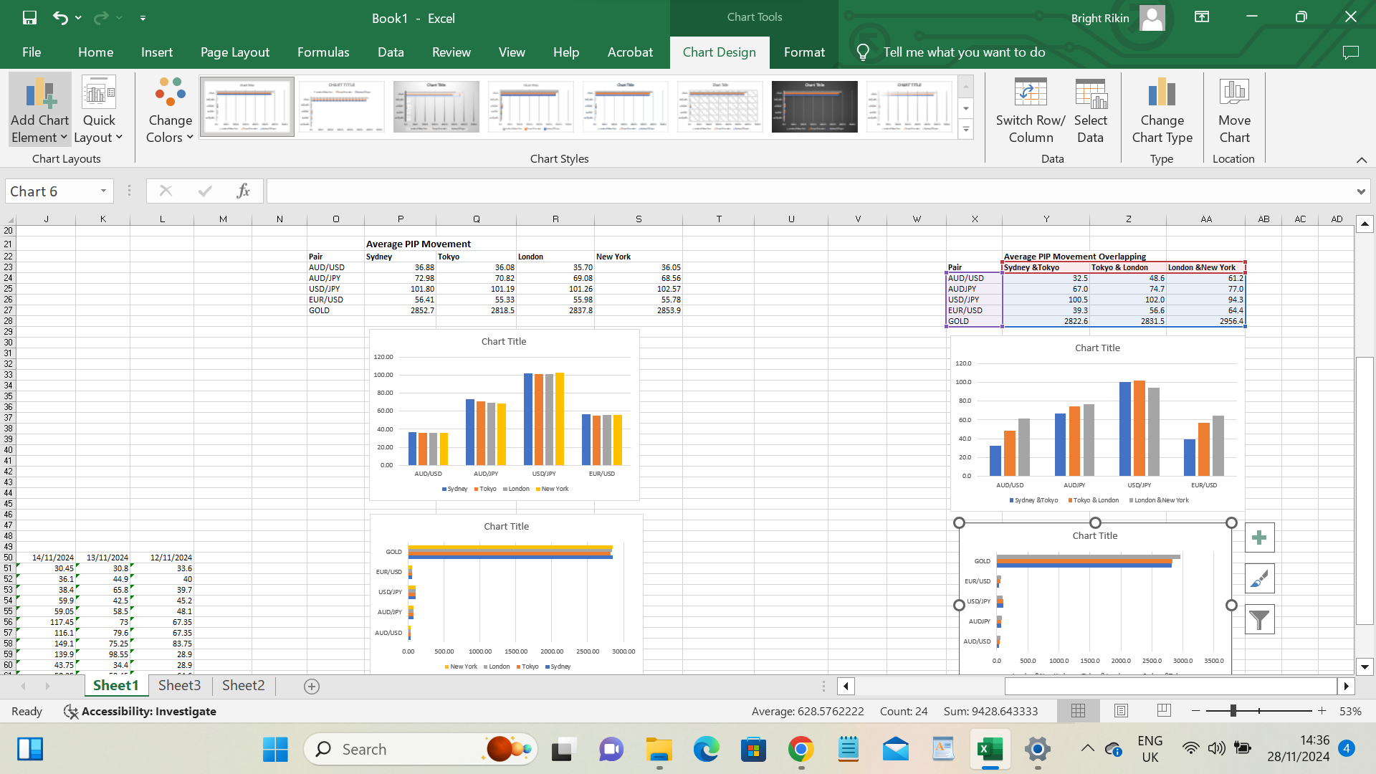
Average PIP Movement/Overlappings

Slide 12
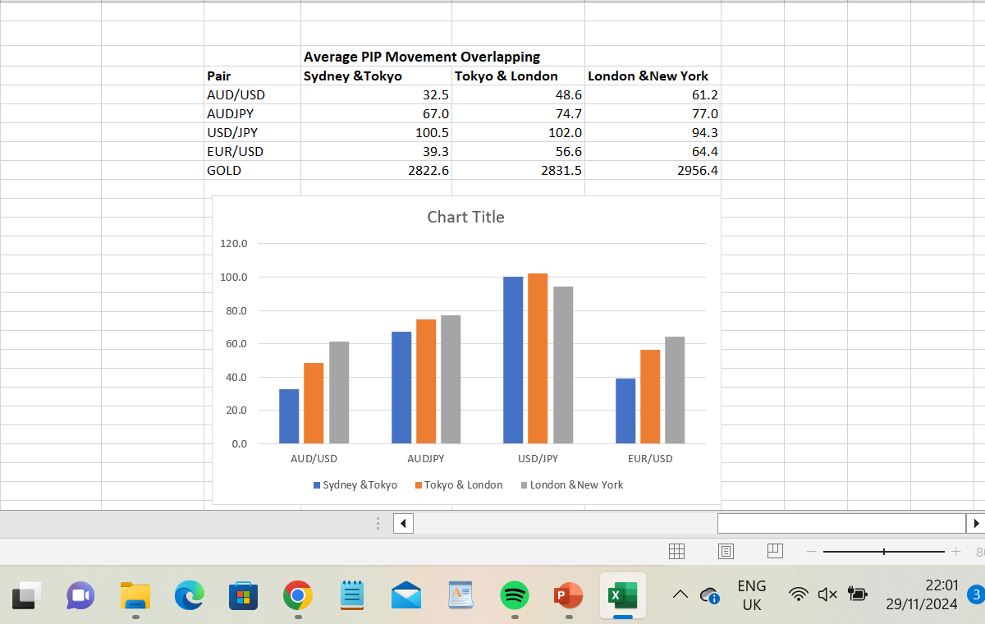
Graphical Representation

Slide 13
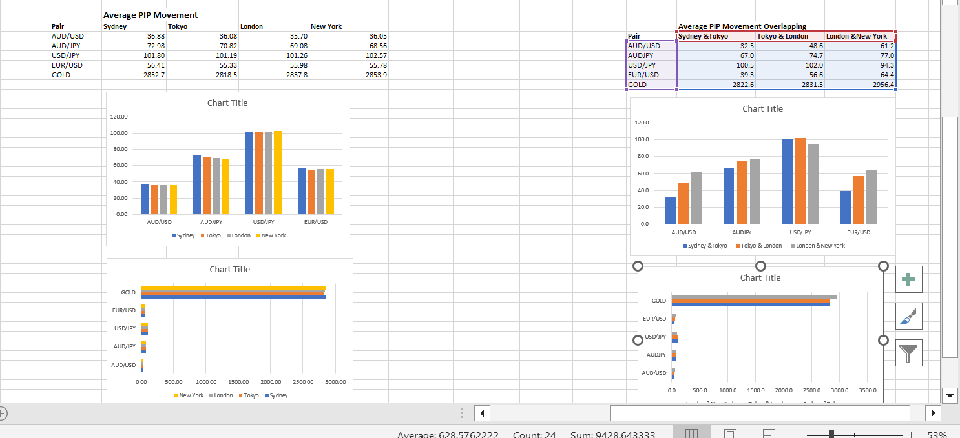
Graphical Representaion

Slide 14
Interpretation of Trading in Individual Sessions
Sydney Session
Characteristics:
The Sydney session is generally quieter, with moderate pip movements due to lower liquidity as it kicks off the global trading day.
Trading Opportunities:
Ideal for swing traders seeking to enter or adjust positions for longer-term trades.
Currency Pairs: AUD/USD and NZD/USD are prominent due to their local economic activities and announcements.

Slide 15
Interpretation of Trading in Individual Sessions
Tokyo Session
Characteristics:
Moderate volatility as the Asian markets dominate, with pip movements slightly higher than Sydney.
Trading Opportunities:
Steady trends allow intra-day traders to capture moderate gains.
Currency Pairs: USD/JPY, AUD/JPY, and EUR/JPY offer excellent opportunities, as the Japanese yen is heavily traded during this session.

Slide 16
Interpretation of Trading in Individual Sessions
London Session
Characteristics:
The London session sees a surge in pip movements due to increased liquidity and participation from European markets.
Trading Opportunities:
Suitable for scalping and short-term trading strategies due to high volatility.
Currency Pairs: EUR/USD, GBP/USD, and USD/CHF benefit from European market activity.

Slide 17
Interpretation of Trading in Individual Session
New York Session
Characteristics:
Volatility peaks due to high trading volume and major economic announcements from the U.S.
Trading Opportunities:
Favorable for short-term traders looking to capitalize on news-driven movements.
Currency Pairs: USD/CAD, EUR/USD, and XAU/USD (Gold) are popular due to U.S. market influence.

Slide 18
Interpretation of Trading in Overlapping Sessions
Sydney-Tokyo Overlap
Characteristics:
Pip movement begins to rise as both Australian and Asian markets contribute liquidity.
Trading Opportunities:
Best for trading AUD and JPY pairs with steady movement.
Currency Pairs: AUD/JPY, AUD/USD.

Slide 19
Interpretation of Trading in Overlapping Sessions
Tokyo-London Overlap
Characteristics:
Significant increase in volatility as liquidity from Asian and European markets intersect.
Trading Opportunities:
Active time for trend continuation trades established during the Tokyo session.
Currency Pairs: EUR/JPY, GBP/JPY, and USD/JPY.

Slide 20
Interpretation of Trading in Overlapping Sessions
London-New York Overlap
Characteristics:
This is the most volatile period due to the convergence of the two largest global markets.
Trading Opportunities:
Excellent for scalping and breakout trades.
Currency Pairs: EUR/USD, GBP/USD, USD/JPY, and Gold.

Slide 21
Comparison of Overlaps and Individual Sessions
Volatility: Overlapping sessions, especially London-New York, show significantly higher volatility compared to individual sessions, presenting more trading opportunities for short-term traders.
Pip Movement: Overlaps consistently exhibit higher pip movements, as seen in the data:
Sydney-Tokyo: Moderate increase from Sydney.
Tokyo-London: Marked rise due to participation from both Asian and European markets.
London-New York: Peak pip movements across most currency pairs.

Slide 22
Maximizing Profits
For Individual Sessions:
Focus on currency pairs tied to the region, such as AUD/USD during Sydney or USD/JPY during Tokyo.
Use longer-term trend-following strategies to capitalize on moderate pip movements.
For Overlapping Sessions:
Trade high-volatility pairs like EUR/USD or GBP/USD during London-New York overlap.
Utilize scalping or breakout strategies to take advantage of sharp price movements.

Slide 23
Conclusion
In this analysis, we highlighted the unique characteristics of individual trading sessions and overlapping markets. The data underscores the importance of overlaps like London-New York for maximizing trading opportunities, given their high volatility and liquidity. Each session presents unique advantages, with specific currency pairs and commodities like Gold being more active during particular times. By understanding the pip movements and aligning strategies with session dynamics, traders can optimize their decision-making for better profitability.

